Slide 1
Data Cleaning
The data had to be cleaned to perform some operations in Tableau and get the expected results. Hence following data cleaning processes are done to get the exact important data to get some useful insights.
1. Primarily I used the in built Data-interpreter of tableau, then proceed for further cleaning processes.
2. I had to segregate date and time.
3. Then longitude and latitude columns are made using custom split.
4. Some columns are not important for the analysation. Hence they are removed. Like- gender, country, currency, merchant_id etc.
5. Some columns are nearly empty, hence they are being removed. Like- bpay_biller_code, merchant_code etc.

Slide 2
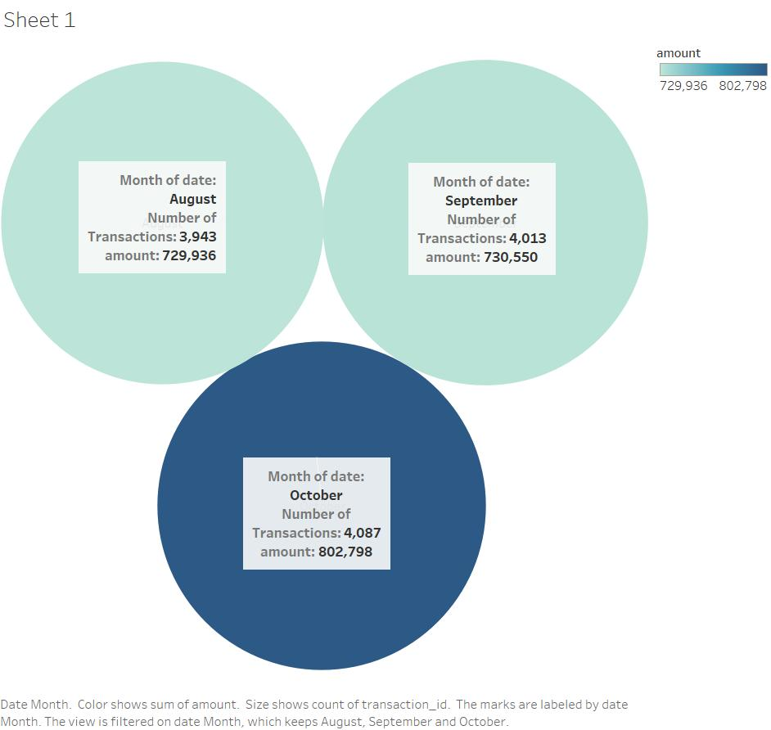
The insights from the dataset given about ANZ customers
First Thing we found is the most balanced account in the bank is of Mr. Patrick with 267129 AUD and the least of Mr. Kimberly with 0.24 AUD!
Secondly we got the monthly transaction amounts. In August total transaction was 7,29,936 AUD, September- 7,30,550 AUD and in October- 8,02,798 AUD
As you can see number of transactions per month comes out to be 3943, 4013, 4087 in August, September and October respectively.
Complete average transaction is approximately 2,26,3300 AUD.

Slide 3
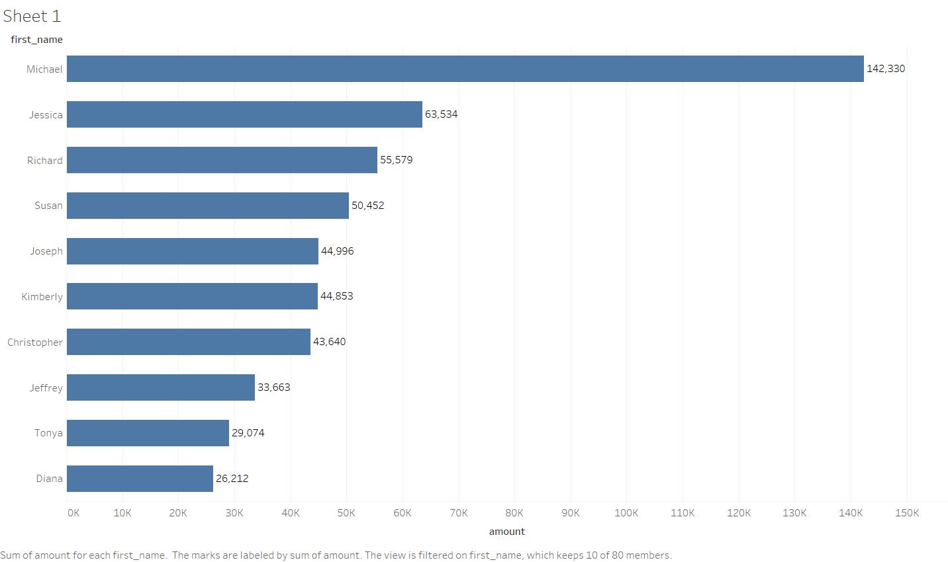
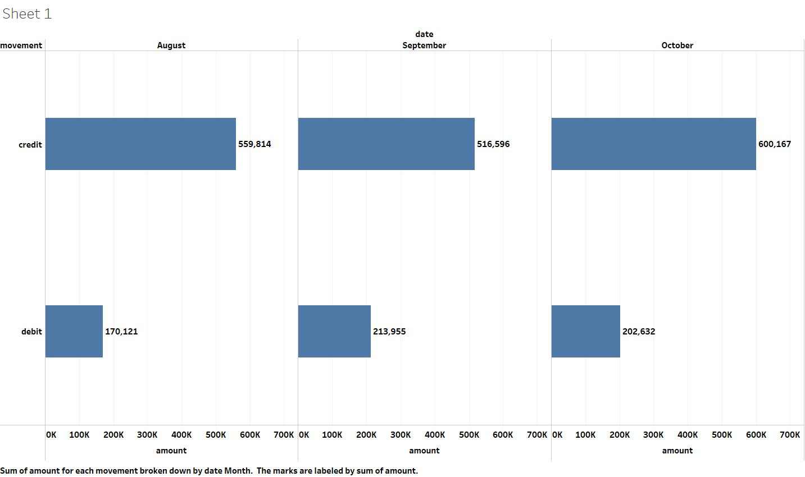
Top 10 transactions in ANZ was done by following 10 people during this 3 months by amount. Total transaction amount for each customers has been labelled.
Below are the total amount for each transaction type per month(Credit/Debit).

Slide 4
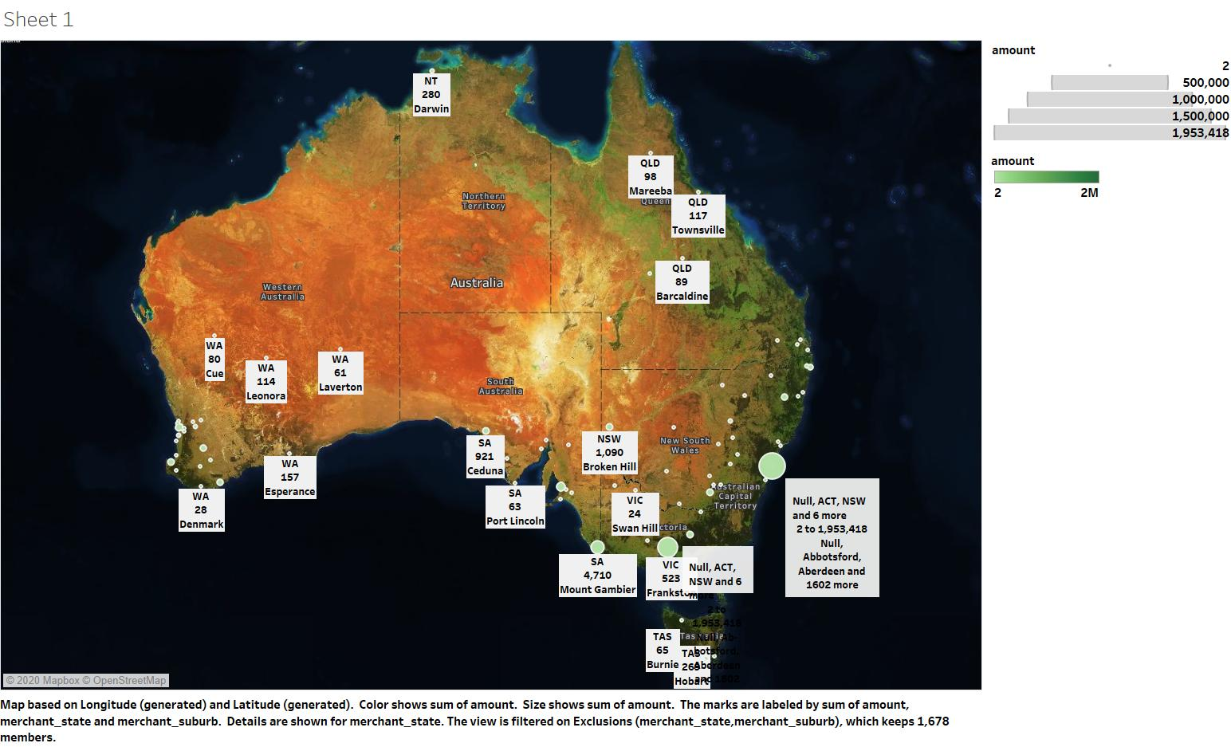
Got some interesting facts from the map plotting the Latitude and Longitude of the states….we can conclude maximum transaction was made in NSW(New South Wales) @102022 AUD and minimum transaction was in TAS(Tasmania) @1963 AUD in this 3 months. Further details are mentioned in the graph below…..

Slide 5
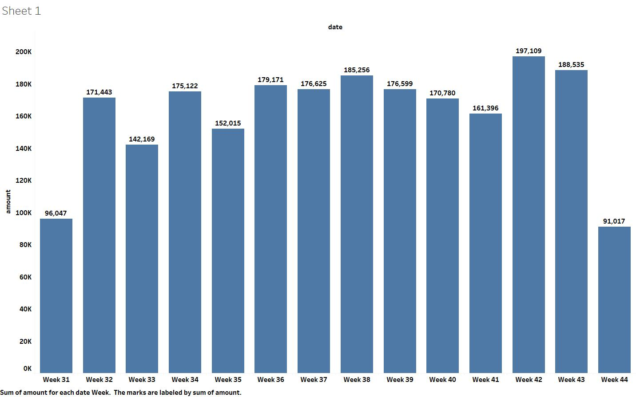
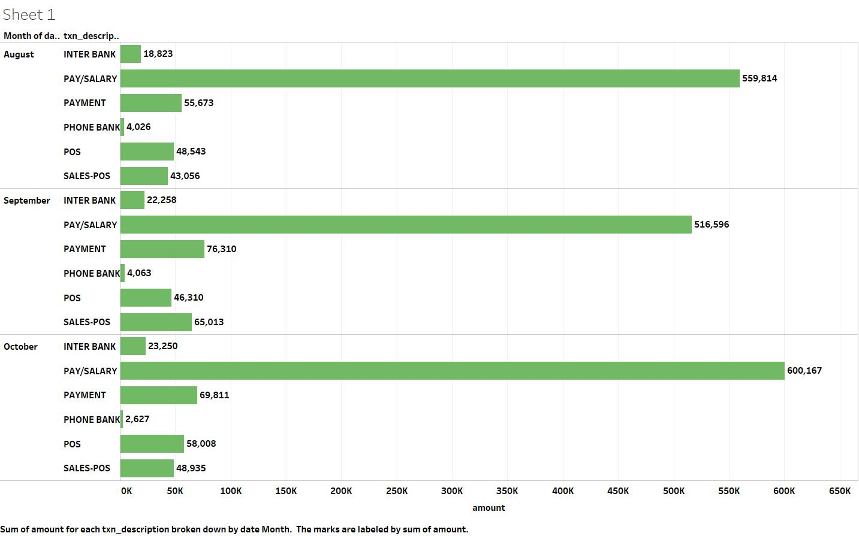
Below weekly transaction details are plotted with week number and the amount transacted in total in that particular week.
Some more interesting insights are found, like how much transaction is done by which type. In this era of digital transaction, phone bank seems not be very popular among these customers. Take a look…..

